Slide 1
An Efficient Algorithm: Build the Heap in Place
  1. Position = (numItems-2)/2; // initial position – the parent of the last item
  2. siftDown item at that position.
  3. Decrement position by one.
  4. Repeat steps 2,3,4 until position is 0.
  public void buildHeap( )
  {
  for( int i = (numItems -2)/2; i >= 0; i-- )
  siftDown( i );
  }
1
8
12
6
15
9
5
13
14
7
10
11
4
2
3
1
siftDown
starts here
8
12
6
15
9
5
Its parent
13
14
7
10
11
4
2
3
Last item

Slide 2
An Efficient Algorithm
  for( int i = (numItems -2) / 2; i >= 0; i-- )
  siftDown( i );
1
8
12
siftDown(3)
siftDown(4)
siftDown(5)
siftDown(6)
6
15
9
5
13
14
7
10
11
4
2
3

Slide 3
An Efficient Algorithm
  for( int i = (numItems -2) / 2; i >= 0; i-- )
  siftDown( i );
1
siftDown(1)
siftDown(2)
8
12
siftDown(3)
siftDown(4)
siftDown(5)
siftDown(6)
14
15
11
5
13
6
7
10
9
4
2
3

Slide 4
An Efficient Algorithm
  for( int i = numItems / 2 - 1; i >= 0; i-- )
  siftDown( i );
siftDown(0)
1
siftDown(1)
siftDown(2)
15
12
14
10
11
5
13
6
7
8
9
4
2
3

Slide 5
An Efficient Algorithm
  for( int i = numItems / 2 - 1; i >= 0; i-- )
  siftDown( i );
siftDown(0)
15
14
12
13
10
11
5
1
6
7
8
9
4
2
3

Slide 6
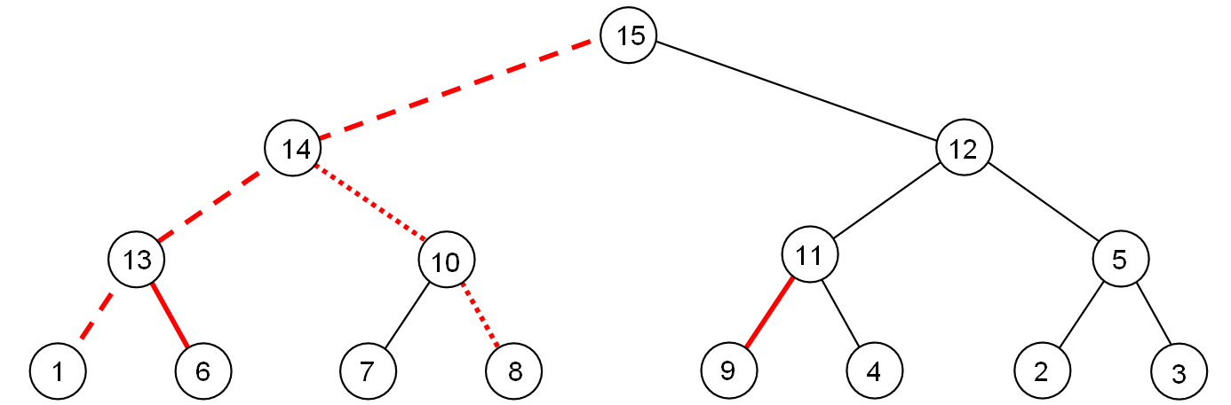
Running Time Analysis
O(NlogN) as siftDown() is called N/2 times, and each takes no more than O(logN) time.
However, this running time is not tight. The cost of BuildHeap is bounded by the number of red lines (all red lines)
  …which is at most the sum of heights of all nodes of the heap.
This sum is O(N), where N is the number of nodes in the heap.

Slide 7
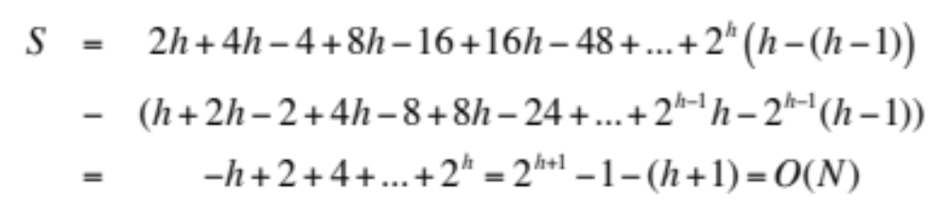
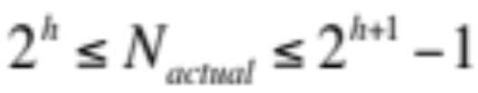
Running Time Analysis
For a perfect binary tree of height h, N = 2^{h+1}-1:
  1 node at height h
  2 nodes at height h-1
  4 nodes at height h-2
  …
  2^{h-1} nodes at height 1
  2^{h} nodes at height 0
  Total height of all nodes
Although a complete tree is not a perfect binary tree, but number of nodes in a complete tree of height h is:
Thus the actual number of nodes is within a factor of 2 of N. Hence, S = O(N_{actual})

Slide 8
Merge Two Heaps
Merge two heaps into a single one.
Append one heap to the end of the other, and then just like buildHeap, sift down the interior nodes
  Running time = O(?)

Slide 9
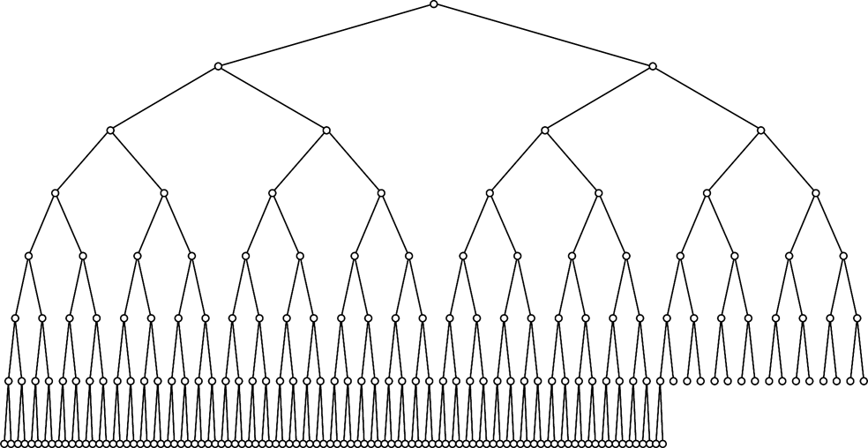
Running Time of Binary Heap Operations
Summary of the worst-case running time of binary heap operations (max-at-top)
  findMax O(1)
  removeMax() O(logN)
  insert() O(logN)
  buildHeap() O(N)
  merge() O(N)
Average-case running time is
different for insertion. It takes
O(1) average time (about 2.6
comparisons)
unlikely
Even less likely
Less likely
More likely siftUp goes here

Slide 10
Applications of Heaps
EECS 233

Slide 11
Application #1: Heap-sort
Sorting algorithms: given an arbitrary array, re-position the items in the array in ascending or descending order
A naïve algorithm (we will learn more later)
It isn’t efficient (O(n²)), because it performs a linear scan to find the smallest remaining item (O(n) steps per scan).
15
7
13
5
4
6
11
16
9
4
7
13
5
15
6
11
16
9
4
5
13
7
15
6
11
16
9
4
5
6
7
15
13
11
16
9

Slide 12
Heap-Sort
Heap-sort is a sorting algorithm that repeatedly finds the largest remaining item from a heap and puts it in place.
  void heapSort(T[] arr, int numItems) {
    // Turn the array into a max-at-top heap.
    buildHeap(arr, numItems);
    int endUnsorted = numItems - 1;
    while (endUnsorted > 0) {
      // Get the largest remaining item and put it to the end
      T largestRemaining = removeMax(arr);
      arr[endUnsorted] = largestRemaining;
      endUnsorted--;
    }
  }
It is efficient:
  O(N) to turn the array into a heap
  O(log N) to remove the largest remaining item
  N above removals
  O(N log N) overall

Slide 13
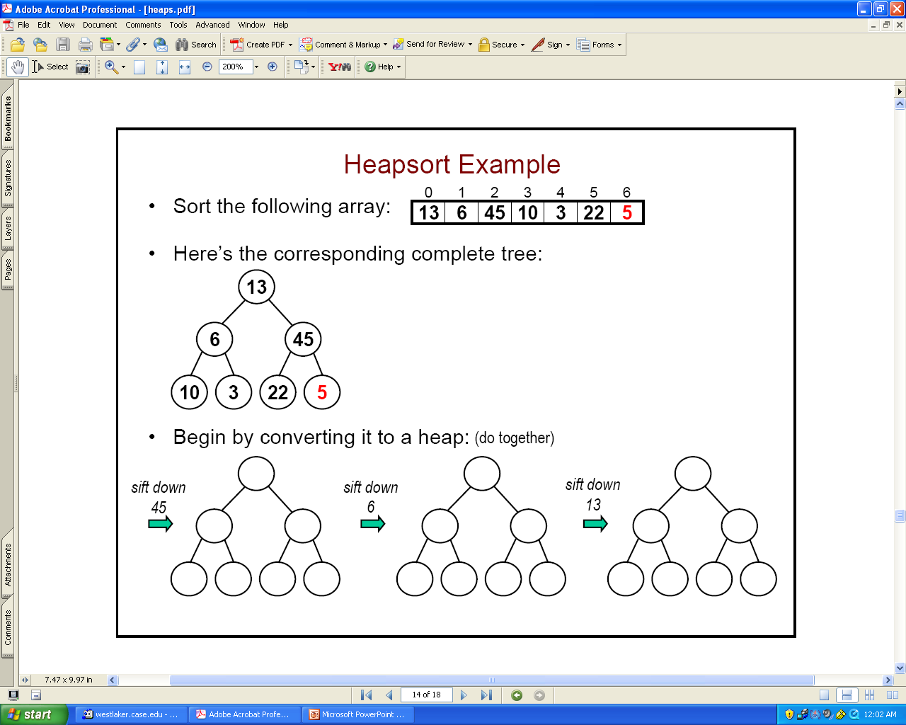
Heap-Sort Example: (1) Build the Heap
Sort this array:
The corresponding complete tree:
First call BuildHeap():
13
6
45
10
3
22
5
5
45
10
10
22
5
6
5
6
13
5

Slide 14
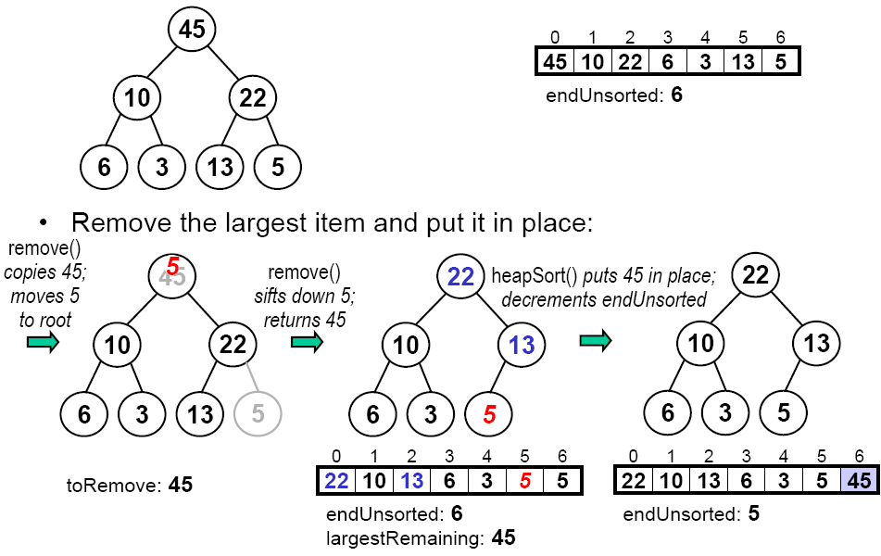
Heap-Sort Example: (2) Drain the Heap
Remove the largest item from heap:

Slide 15
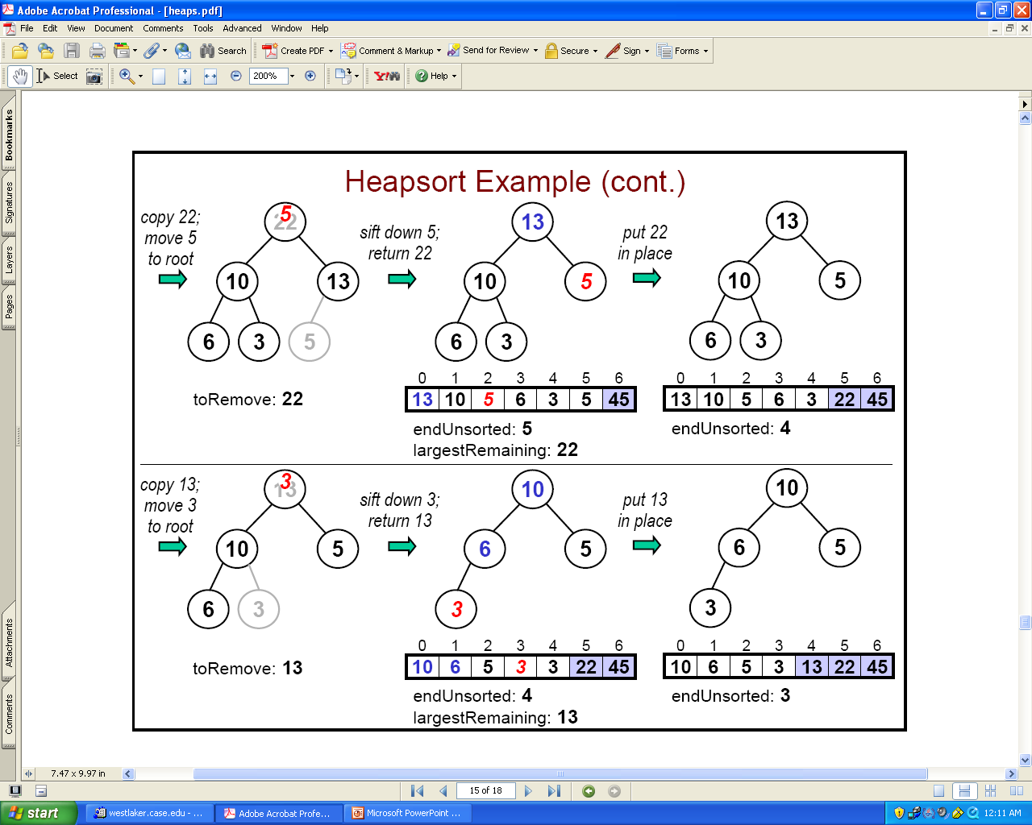
Remove the Next Largest Items

Slide 16
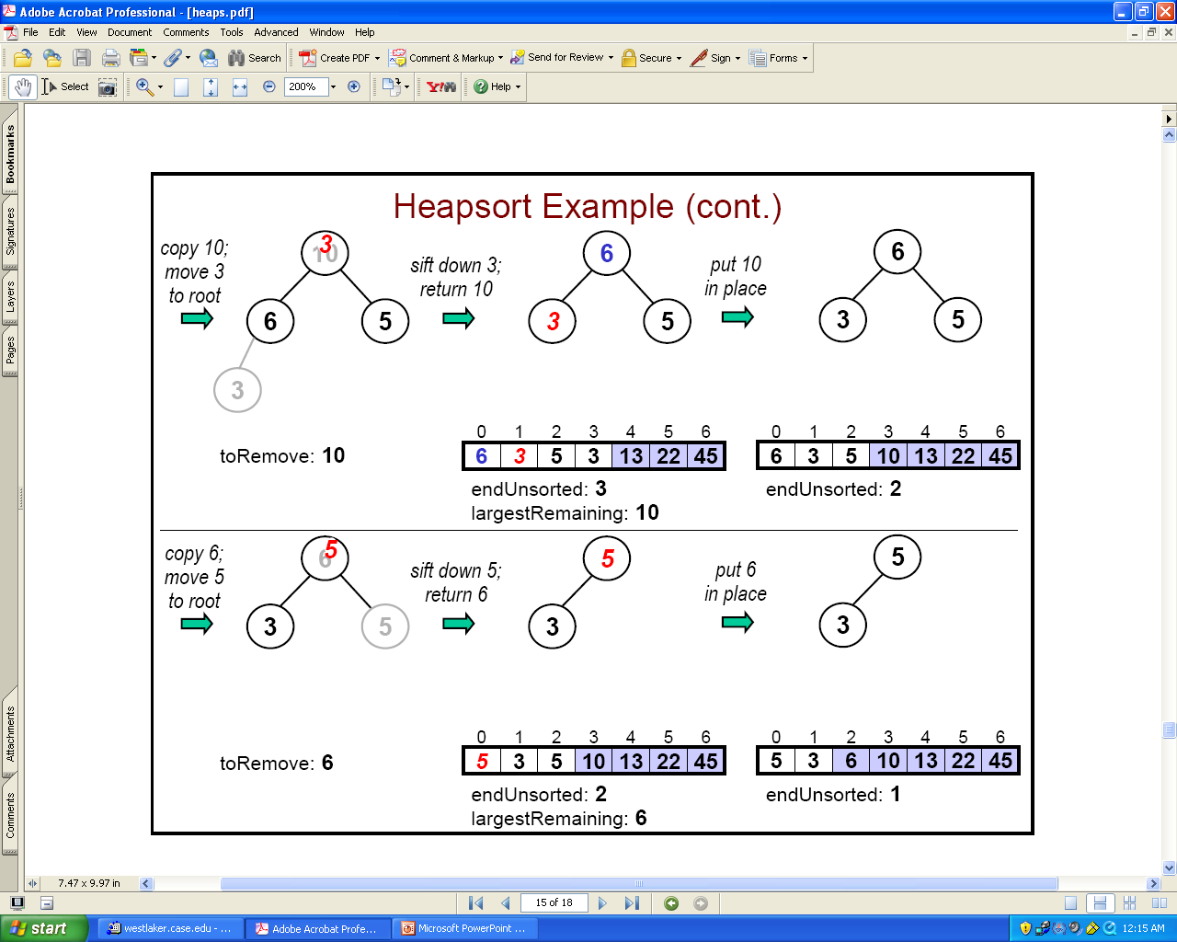
Keep Going

Slide 17
Application #2: The Selection Problem
Given a list of N items and an integer k (1 <= k <= N), find out the k-th largest item (or k largest items) in the list. E.g., N=1,000,000 and k=100, or k=N/2
Example:
  List of items: 4, 9, 0, 3, 5, 7, 10, 12, 2, 8
  12 10 9 8 7 5 4 3 2 0 (sorted order of items)
  1st largest item is: 12
  10th largest item is: 0
  6th largest item is: 5
What is your method?

Slide 18
The Selection Problem: Naïve Methods
Naïve method 1
  Sort N items: O(N²) (for a simple sort algorithm), O(NlogN) for heap-sort (and a number of other algorithms we will learn)
  Retrieve the k-th largest item: O(1)
No so naïve method 2
  Read k items into an array A: O(k)
  Sort the items in the array A: O(k²) (actually O(k log k) but no matter)
  For each of the remaining items: (N-k) of them (new_item)
    Compare new_item to the last (smallest) item in A, last_item. If new_item is larger than last_item, replace last_item with new_item and put the latter into correct spot in the array: O(k)
  The final array contains the top-k items
  Total Running time: O(k + k² + (N-k) * k) = O(Nk).

Slide 19
The Selection Problem: Efficient Method 1
Use heaps!
To find the k-th largest item.
  Read N items into an array O(?)
  Apply buildHeap() to the array O(?)
  Perform k removeMax() operations. O(?)
    Last operation will give us the k-th largest one.
What is the total running time? O(?)
O(N + klogN)

Slide 20
The Selection Problem: Efficient Method 2
From the idea of the second naïve method: at any time maintain a set S of k largest item.
To find the k-th largest item.
  Read k items into a min-on-top heap S (of size k). O(?)
  For each remaining item (N-k) of them
    Compare it with the smallest item (root) in heap S
    If item is larger than root, then put it into S instead of root.
    Sift down the root if necessary. O(?)
Running time: O(k+(N-k)logk) = O(?)
  Compared to O(N + klogN) of Efficient Method 1
  Which is better?

Slide 21
Exercise: Update An Item
Update an item and return the old one
public T update(int i, T item) {
  T oldItem = items[i];
  ?
  return oldItem;
}
Running time?
items[i] = item;
if (item.compareTo(oldItem) == 1)
siftUp(i);
else
siftDown(i);
23
45
23
17

Slide 22
Delete An Arbitrary Item (Not RemoveMax())
public T delete(int i) {
  T toDelete = items[i];
  ?
  return toDelete;
}
Running time?
items[i] = item[numItems - 1];
numItems--;
if (toDelete.compareTo(items[i]) == -1)
siftUp(i);
else
siftDown(i);
23
45

